Slide 1
Deprivation Across the
Central South Region
ONS Local
ONS.Local.South@ons.gov.uk

Slide 2
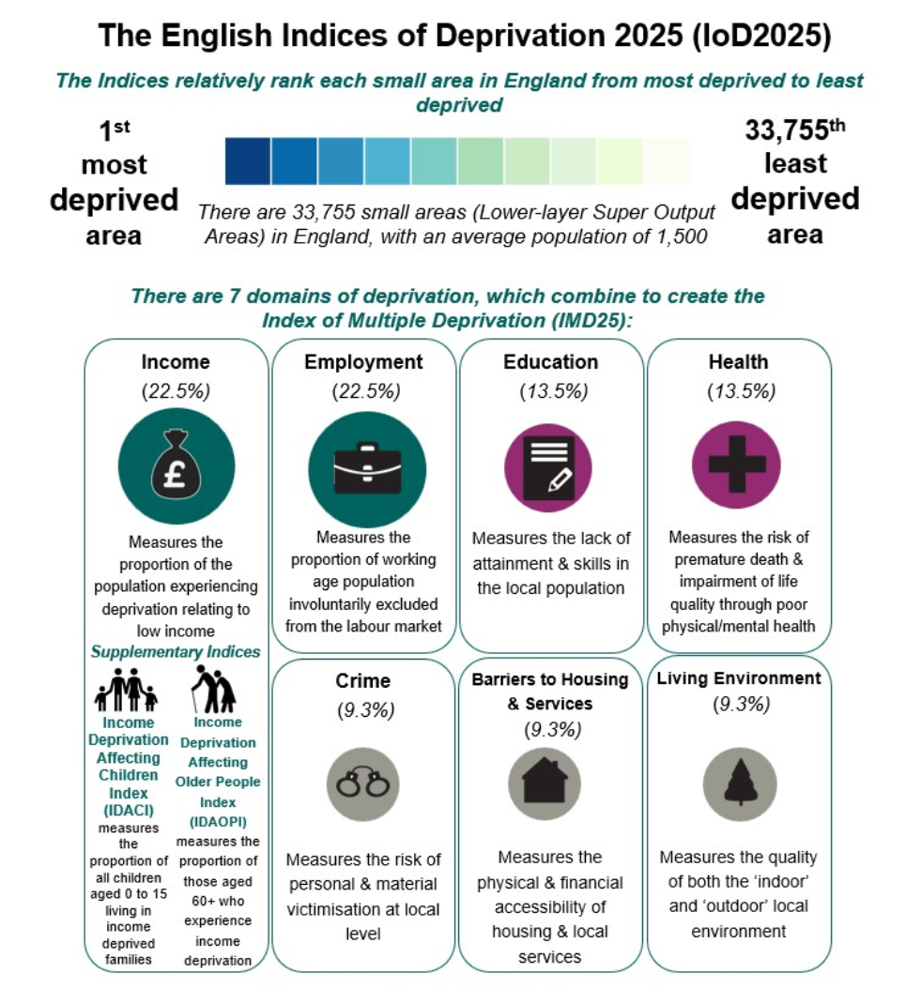
English Indices of Deprivation 2025 – IoD25
IoD25 measures deprivation in neighbourhoods in England
  Neighbourhoods are made up of 400-1,200 households
  There’s a total of 33,755 neighbourhoods in England
Deprivation is measured across 7 ‘domains’
  Income, employment, health, education, crime, housing, living environment
  These are combined to create one overall measure: The Index of Multiple Deprivation (IMD25). This gives each neighbourhood a single score used to rank it.
Neighbourhoods are ranked using IMD from most deprived to least deprived
  Rank of 1 = most deprived
  Rank of 33,755 = least deprived
  The ranked areas are divided into 10 equal groups called ‘deciles’
    Decile 1 = most deprived 10%
    Decile 10 = least deprived 10%

Slide 3
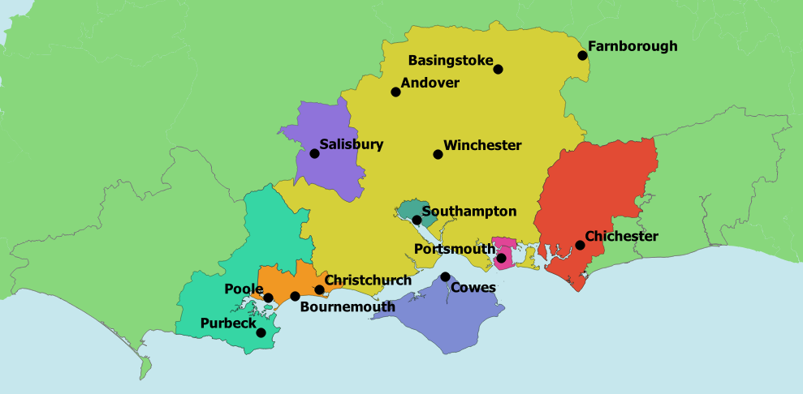
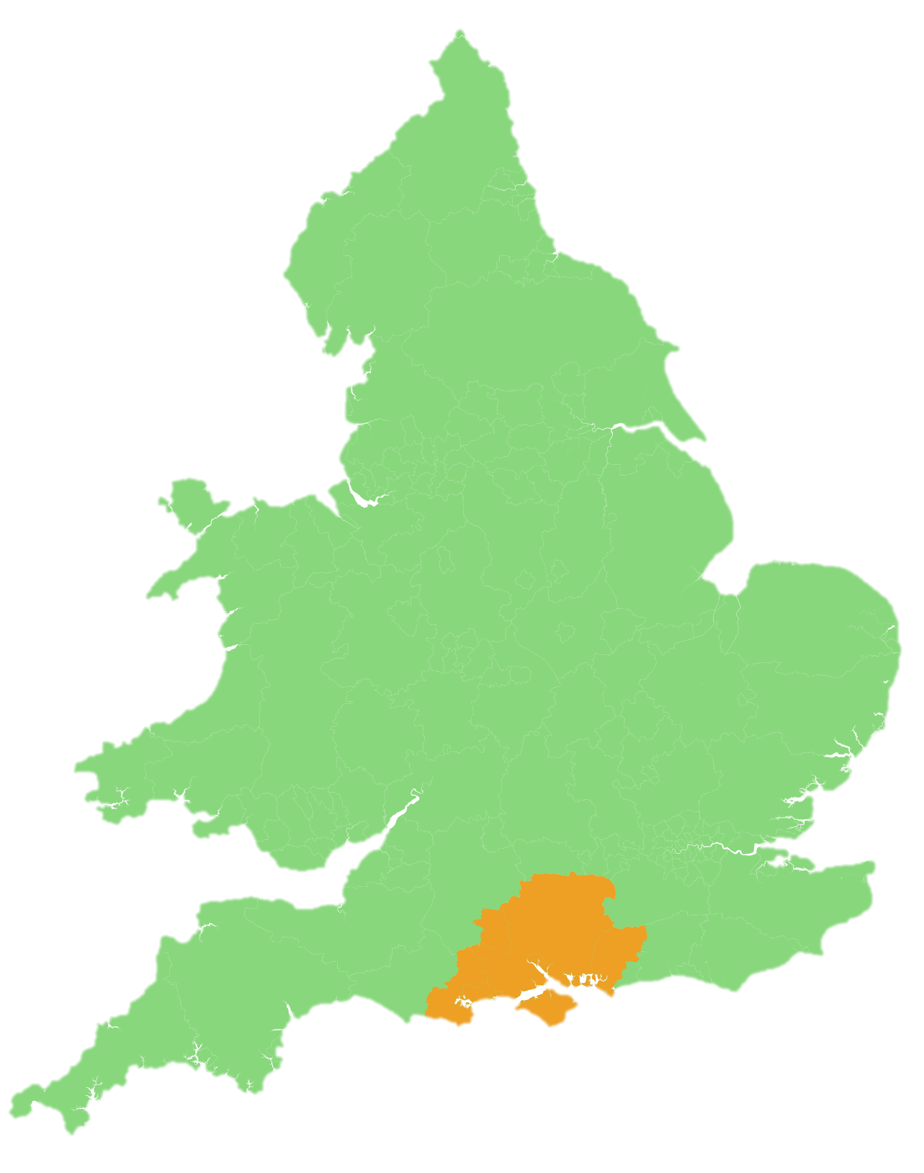
The Central South
The Central South is home to 2.7 million people
2,749,100
Census 2021
1,688 neighbourhoods
Rural, urban, seaside mix
History of port, maritime and defence‑related industries
London commuter areas
Source: Census 2021, ONS

Slide 4
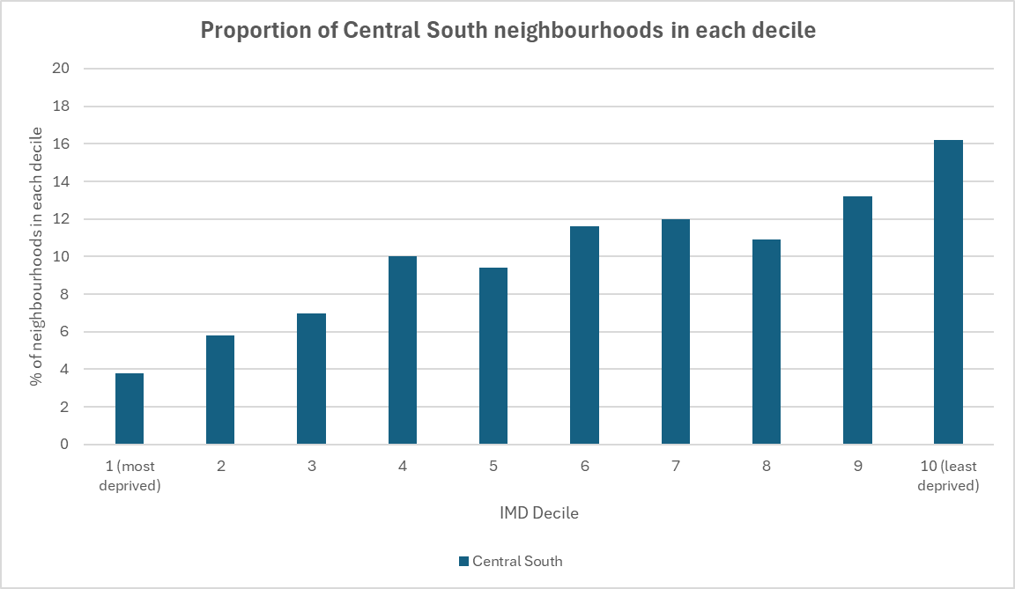
Overall Deprivation in the Central South
When you look at the Central South as a bespoke area…
  The majority of neighbourhoods (63.9%) are in less deprived deciles (6-10)
  Just under 17% of neighbourhoods in the Central South are in the most deprived deciles (1-3).
  The Central South doesn’t appear overly deprived.
But looking at the area as a whole can hide small pockets of deprivation

Slide 5
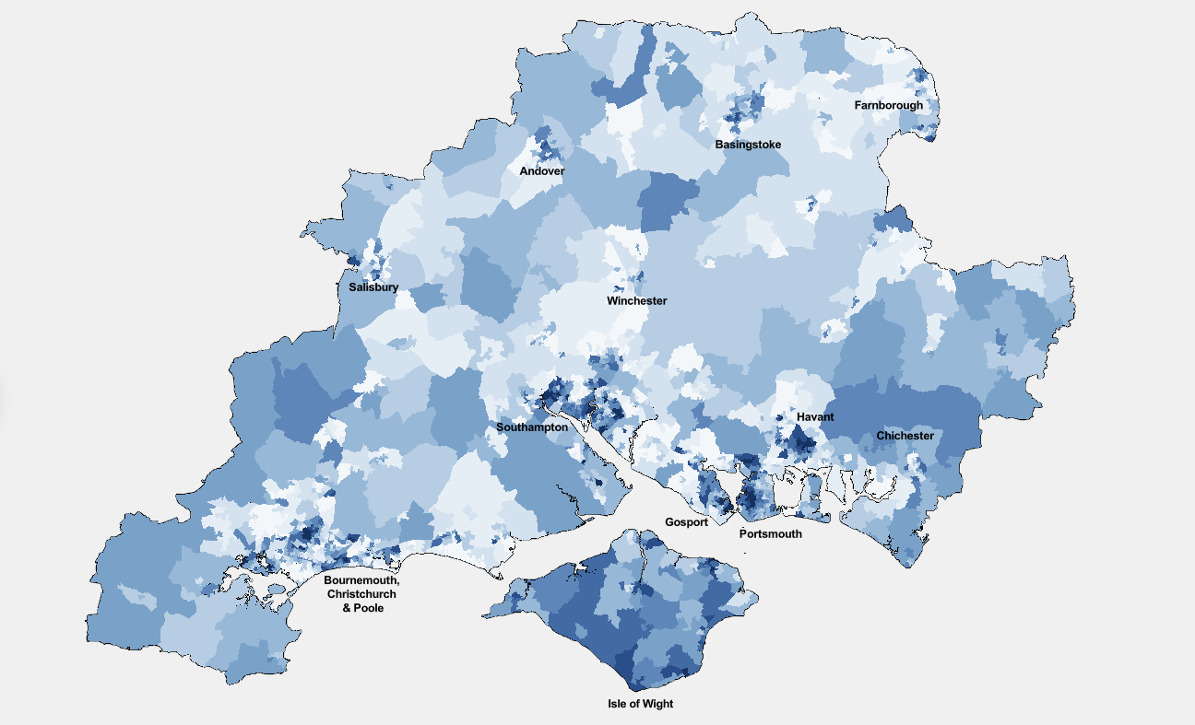
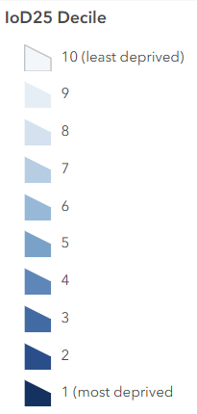
Mapping deprivation in the Central South
IMD Decile
Several neighbourhoods in Portsmouth, Southampton and Havant rank among the most deprived 1% of areas nationally.

Slide 6
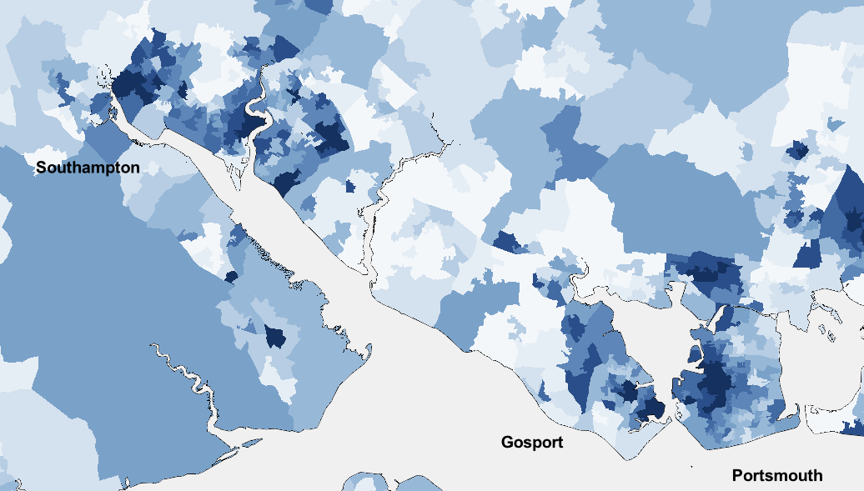
Mapping deprivation in the Central South
IMD Decile
When you take a closer look, you can see highly deprived neighbourhoods next door to highly affluent neighbourhoods – especially in urban areas.

Slide 7
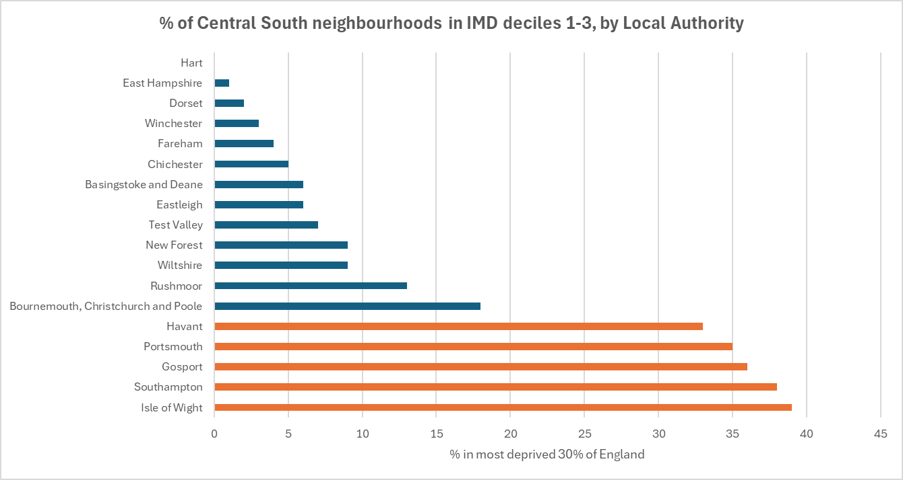
Which Local Authorities are the most deprived?
Isle of Wight, Southampton, and Gosport have the highest percentage of neighbourhoods in the most deprived 30% of England within the Central South, closely followed by Portsmouth and Havant.

Slide 8
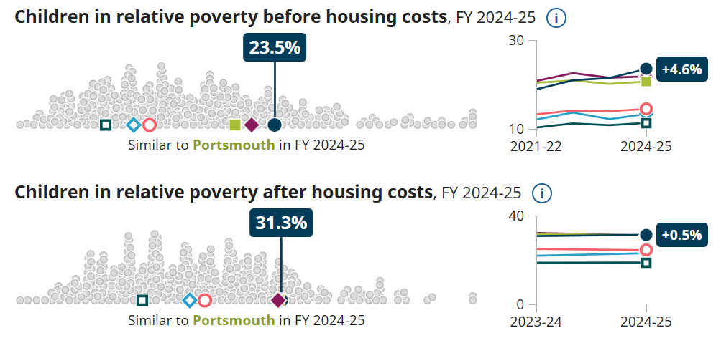
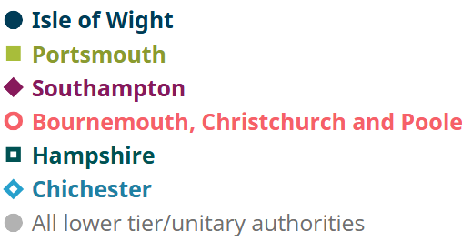
Children in relative poverty
In many areas, the proportion of children living in relative poverty is above the average for the South East.
Source: Explore Local Statistics, DWP

Slide 9
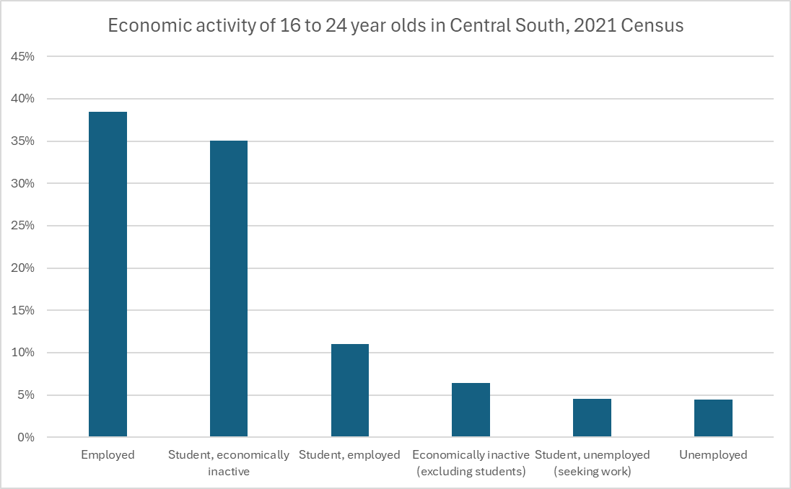
Young people in employment or training
At the 2021 Census, youth unemployment levels were similar in Central South to the rest of England and Wales.
Source: Census 2021, ONS

Slide 10
Employment, Health, and Education deprivation
Southampton, Isle of Wight and Gosport are the most employment, health, and education deprived areas in the Central South.
42% of the Isle of Wight’s neighbourhoods are in the most deprived 30% of England for Employment.
  More working age people are involuntarily excluded from the labour market
63% of Southampton's neighbourhoods are in the most deprived 30% of England for Health.
  People live shorter lives and have lower life quality because of poor physical or mental health
62% of Gosport's neighbourhoods are in the most deprived 30% of England for Education.
  There’s a lack of qualifications and skills in the local population

Slide 11
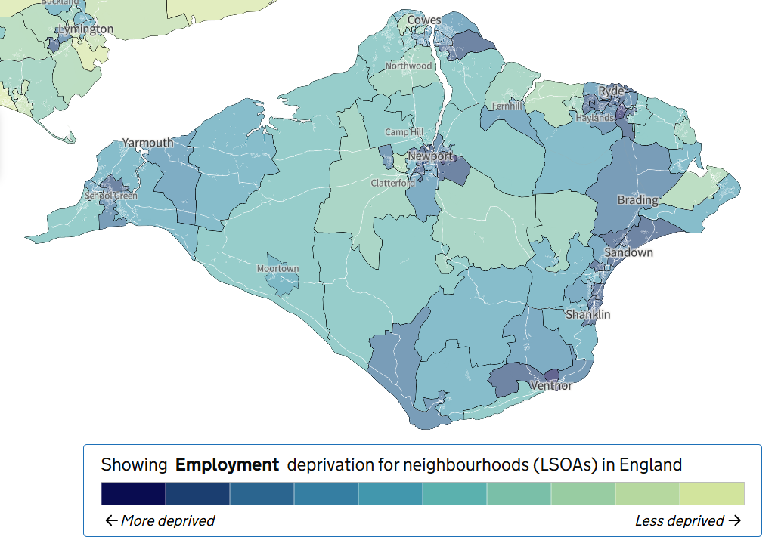
The Isle of Wight is the most employment deprived area in the Central South
The Employment domain measures ‘the proportion of the working age population involuntarily excluded from the labour market.’
42% of Isle of Wight neighbourhoods are in the most deprived 30% of England for Employment.
Rate of employment for 16-64 year olds was 72.6% in the Isle of Wight, which is lower than the South East regional average of 79.3%.
The Isle of Wight has below average:
Gross disposable household income per head
Gross median weekly pay
Gross value added per hour worked
GDP per head
Total population: 140,459
89 neighbourhoods
Explore Local Statistics, ONS

Slide 12
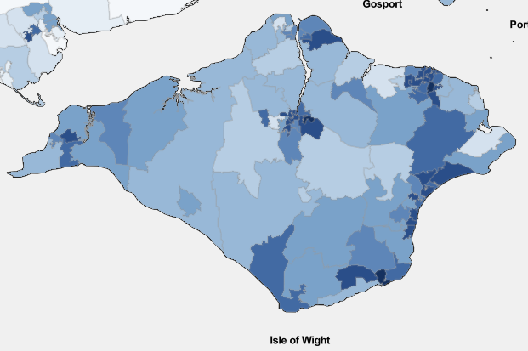
Why is the Isle of Wight so employment deprived?
Employment Decile
Job opportunities
  Gross weekly pay for those working full-time on the Isle of Wight was ​around 20% lower than the South East average in 2025.
  The island’s geography and access to ferries may limit access to wider job opportunities
Skills gaps
  Among the working age population, 5.5% had no qualifications, higher than South East average.
  35% of Isle of Wight neighbourhoods were in IMD deciles 1-3 for Education
Health barriers may limit people’s ability to work
  52% of Isle of Wight neighbourhoods were in IMD deciles 1-3 for Health
  Healthy life expectancy in the Isle of Wight was 58.6 years for men and 59.3 for women in 2022-2024 (Source: Healthy life expectancy)
  Of economically inactive working age residents, 35.9% were long term sick or Disabled.
Labour Market Profile, APS and ASHE

Slide 13
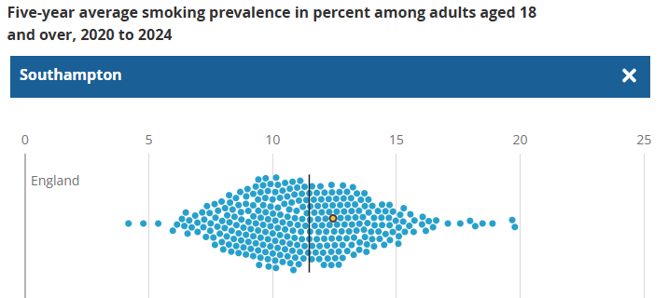
Health in Southampton
Southampton demographics
Population: 248,922
Age 16-64: 68.3%
Age 65+: 13.7%
Highest proportion of people are in the 35-49 age bracket (19.8%)
The Health domain of deprivation measures ‘the risk of premature death and impairment of life quality through poor physical/ mental health.’
Premature mortality:
  Under-75 mortality from preventable causes in Southampton is 196.9 deaths per 100,000 people (England average is 151.2 per 100,000)
  Southampton has an overall mortality rate of 1,032 deaths per 100,000 compared with 964 per 100,000 nationally
  Under-75 mortality is 2.7 times higher in Southampton’s most deprived areas compared with its least deprived areas
Smoking prevalence:
  Estimated at 12% of adults in Southampton (England average is 10.4%)
  In the most deprived areas, 24.2% of adults smoke compared to 8.4% in the least deprived areas
  Major contributor to Chronic Obstructive Pulmonary Disease (COPD), cardiovascular disease, cancer, premature mortality and lower healthy life expectancy
The average percentage of current smokers by local authority

Slide 14
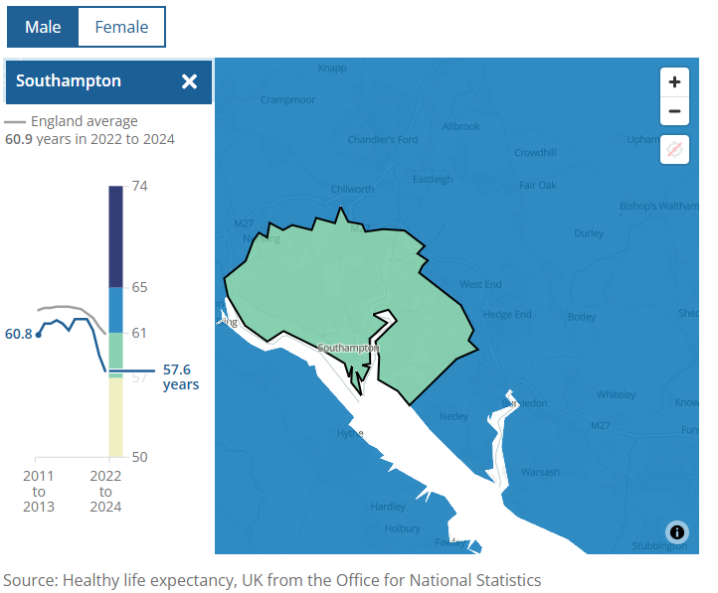
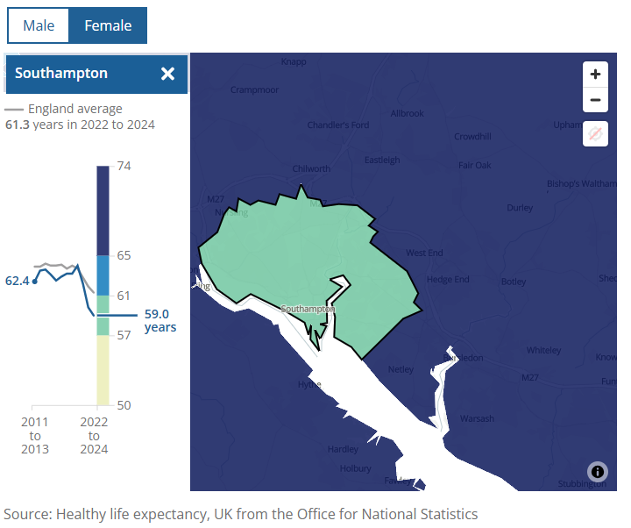
Health in Southampton cont.
The Health domain of deprivation measures ‘the risk of premature death and impairment of life quality through poor physical/ mental health.’
Healthy Life Expectancy (HLE):
  Male HLE in Southampton in 2022-2024 is 57.6 years
  Female HLE in Southampton in 2022-2024 is 59 years
  Both lower than England averages (60.9 and 61.3 years for males and females respectively)

Slide 15
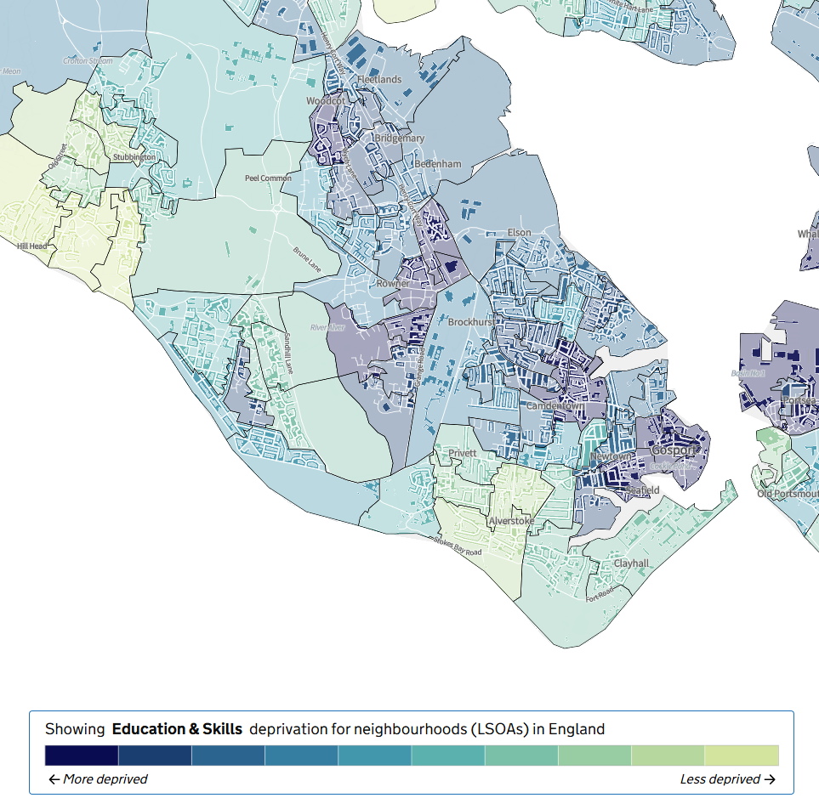
Education in Gosport
Many of the neighbourhoods in Gosport are among the 30% most deprived in the country for education.
Higher than average:
  Further education and skills learner achievements and participation
Below average:
  GCSEs in English and maths by age 19
  Level 3 or above qualifications
  Pupils meeting the expected standards by the end of Key Stage 2
  Literacy and maths skills in early years
Sources: English indices of deprivation 2025
Department for Education
Explore Local Statistics

Slide 16
Summary
Overall, the Central South appears less deprived, but there are high pockets of deprivation in certain neighbourhoods.
Several neighbourhoods in Portsmouth, Southampton and Havant rank among the most deprived 1% of areas nationally.
Isle of Wight, Southampton, and Gosport have the highest percentage of neighbourhoods in the most deprived 30% of England within the Central South. They are also the most health, employment and education deprived areas of the Central South region.

